Slide 1

Analysis of multiplex networks with Python
Matteo Magnani
InfoLab, Dept. of Information Technology
Uppsala University
http://infolab.it.uu.se @uuinfolab
matteo.magnani@it.uu.se @matmagnani
Luca Rossi
NERDS group
IT University of Copenhagen
http://nerds.itu.dk @nerdsitu
lucr@itu.dk @LR
^{This work was} partially supported by the European Community through the project “Values and ethics in Innovation for Responsible Technology in Europe” (Virt-EU) funded under Horizon 2020 ICT-35-RIA call Enabling Responsible ICT-related Research and Innovation.

Slide 2
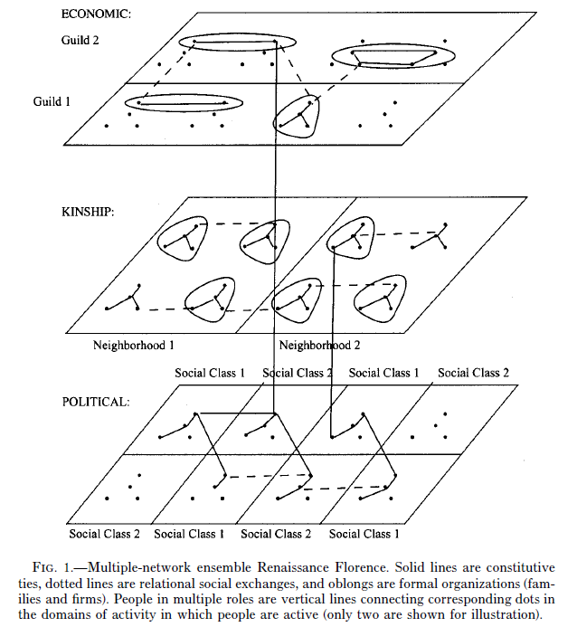
Multiplex networks
Padgett & McLean, 2006
Moreno, 1934

Slide 3
Multiplex networks as multilayer networks
One actor
edge
vertex
Two edge types (layers)

Slide 4
Multiplex networks as multilayer networks
Multi-relational networks
(collaboration, leisure, bullying, knowledge exchange, …)
Connections on different social network platforms
(Twitter, YouTube, Facebook)
Different types of connections on the same platform
(follow, RT, reply, mention, like)
Topical conversational networks
(one topic per layer)
see: Temporal Text Networks (Vega & Magnani, 2018)

Slide 5
Goals for today
At the end of this workshop you should be able to:
Obtain multiplex network data.
Visually explore small multiplex networks.
Compare layers (that is, edge types).
Compute actor measures.
Discover and compare communities.
Activity
Activity
+ material, references

Slide 6
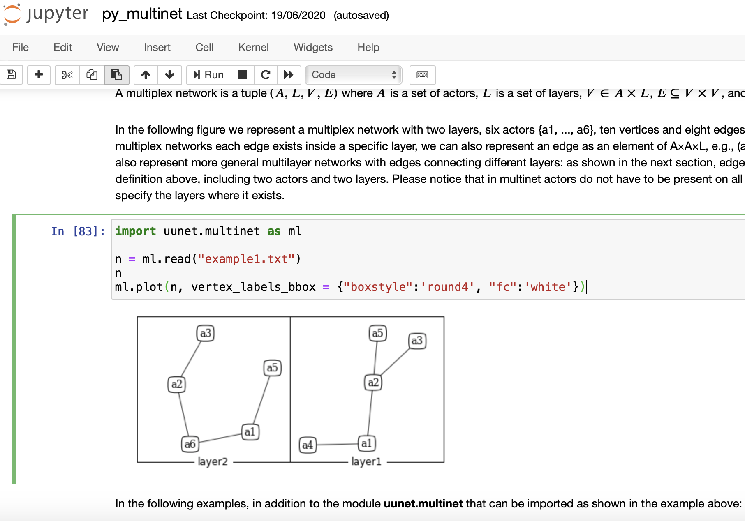
Suggested way to follow along

Slide 7
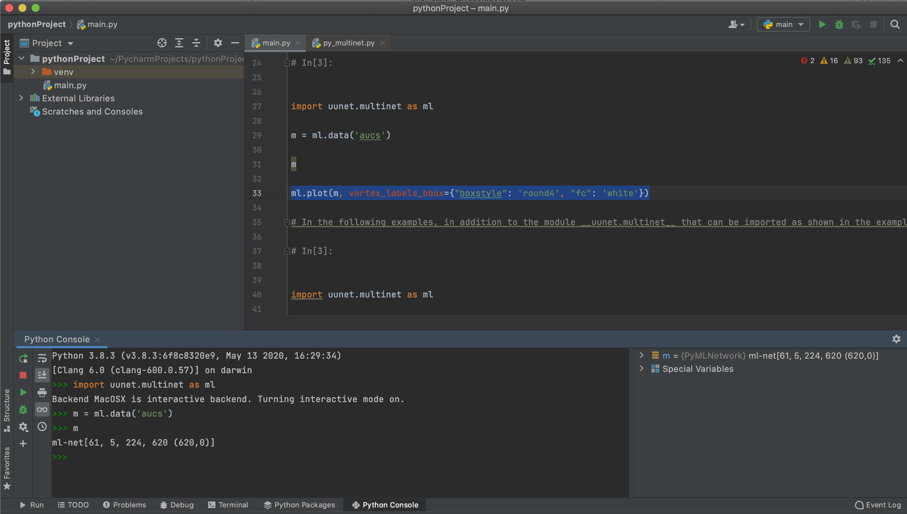
Suggested way to follow along

Slide 8
About the uunet.multinet library
2011 ML-model [1]: started coding our own methods.
2016 Organized previous code to write our book [2].
2017 First version released on CRAN for R (mostly C++).
2021 Major code re-engineering based on multilayer cubes.
Today First tutorial with Python porting.
[1] Magnani & Rossi, 2011
[2] Dickison, Magnani & Rossi, 2016

Slide 9
Set up
import uunet.multinet as ml
import pandas # a utility function
def df(d):
return pandas.DataFrame.from_dict(d)
# to access the documentation, e.g., the data() function:
help(ml.data):

Slide 10
Getting the data
Part 1

Slide 11
Getting network data
Networks can be created in the following ways:
From an empty network: ml.empty()
Manually adding layers, vertices, edges, attributes.
Adding networkx graphs as layers.
Reading it from a file: ml.read()
Growing a synthetic network: ml.grow()
Loading a predefined network: ml.data()
aucs, florentine, sampson, bankwiring, tailorshop.

Slide 12



From an empty network: layers
net = ml.empty()
ml.add_layers(net, ["UL", "BL"])
ml.layers(net)
We start by creating an empty network with two layers, named UL (upper layer) and BL (bottom layer),
New layers are by default undirected. Directed layers are created by setting the directed parameter to True, or using the set_directed function.
dir = { "layer1": ["UL"],
"layer2": ["BL"],
"dir": [True] }
ml.set_directed(net, dir)
layer1 | layer2 | dir
0 | UL | UL | False
1 | UL | BL | True
2 | BL | UL | True
3 | BL | BL | False
df( ml.is_directed(net) )

Slide 13

From an empty network: vertices
The next step to populate a network is to add vertices, where a pair actor-layer defines a vertex. Actors are identified by their name, and are created automatically when vertices are added to the network.
actors = ["A", "B", "C", "A", "B", "C"]
layers = ["UL", "UL", "UL", "BL", "BL", "BL"]
vertices = {"actor": actors, "layer": layers} ml.add_vertices(net, vertices)
 | actor | layer
0​ | C​ | UL​
1​ | A​ | UL​
2​ | B​ | UL​
3​ | C​ | BL​
4​ | A​ | BL​
5​ | B​ | BL​
0​ | C​
1​ | A​
2​ | B​
0​ | UL​
1​ | BL​
df(ml.layers(net))
df(ml.actors(net))
df(ml.vertices(net))

Slide 14

From an empty network: edges
We can now add some edges, in this case between all the vertices in the upper layer and between vertices A and C in the bottom one. Inter-layer edges, although supported, are not exemplified here as we focus on multiplex networks.
from_actor = ["A", "A", "B", "A"]
from_layer = ["UL", "UL", "UL", "BL"]
to_actor = ["B", "C", "C", "C"]
to_layer = ["UL", "UL", "UL", "BL"]
edges = {"from_actor": from_actor,
"from_layer": from_layer,
"to_actor": to_actor,
"to_layer": to_layer}
ml.add_edges(net, edges)

Slide 15
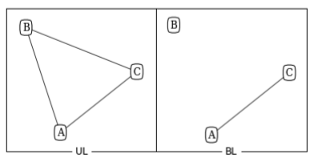
From an empty network: summary
df(ml.edges(net))
Layer specific: df( ml.edges(net, layers1 = ["BL"]))
 | from_actor | from_layer | to_actor | to_layer | dir
0 | A | BL | C | BL | False
1 | A | UL | C | UL | False
2 | A | UL | B | UL | False
3 | B | UL | C | UL | False
df(ml.is_directed(net))
layer1 | layer2 | dir
0 | UL | UL | False
1 | UL | BL | True
2 | BL | UL | True
3 | BL | BL | False
l = ml.layout_multiforce(net, w_inter = [1000])
ml.plot(net, layout = l, vertex_labels_bbox = {"boxstyle":'round4', "fc":'white'})

Slide 16
From an empty network: attributes
The uunet.multinet module provides a set of functions to create attributes and add and retrieve attribute values.
attributes() returns a dictionary with the name of the attribute and its type. It accepts a filtering parameter, target, to limit the query to specific types of objects: "actor" (attributes attached to actors), "vertex" (attributes attached to vertices) or "edge" (attributes attached to edges).
The target is "actor" by default.

Slide 17
Attributes
ml.add_attributes(net, ["name", "surname"])
df( ml.attributes(net) )
 | Name | Type
0 | surname | string
1 | name | string
Using add_attributes() we can also specify different attributes for vertices and edges on individual layers, for which we must supply the layer parameter. If we want, instead, to manage inter-layer edges two parameters are needed, layer1 and layer2.

Slide 18
Attributes
get_values() and set_values() can be used to set and retrieve attribute values. Notice that if an attribute has not been set, then a default value is returned.
ml.set_values(net, "name", ["A", "B"], values = ["Alice", "Barbara"])
df( ml.get_values(net, "name", ["A", "B"]) )
0 | Alice
1 | Barbara

Slide 19
From networkx graphs
A multiplex network can also be created starting from networkx graphs, where each graph represents a layer.
import networkx as nx
l1 = nx.read_edgelist("example_nx1.dat)
l2 = nx.read_edgelist("example_nx2.dat)
n = ml.empty()
ml.add_nx_layer(n, l1, "layer1")
ml.add_nx_layer(n, l2, "layer2")
df( ml.edges(n) )
 | from_actor | from_layer | to_actor | to_layer | dir
0 | A | layer2 | C | layer2 | False
1 | B | layer1 | C | layer1 | False
2 | A | layer1 | C | layer1 | False
3 | A | layer1 | B | layer1 | False

Slide 20
Getting network data
Networks can be created in the following ways:
From an empty network: ml.empty()
Manually adding layers, vertices, edges, attributes.
Adding networkx graphs as layers.
Reading it from a file: ml.read()
Growing a synthetic network: ml.grow()
Loading a predefined network: ml.data()
aucs, florentine, sampson, bankwiring, tailorshop.

Slide 21
Input, output and generation
In uunet.multinet networks can be read from files using a package-specific text-based format, and written to file using the same format or the GraphML syntax.
The uunet.multinet format is not compatible with other packages, but it allows us to specify various details, such as the directionality of intra-layer edges and attributes, as in the following examples.

Slide 22
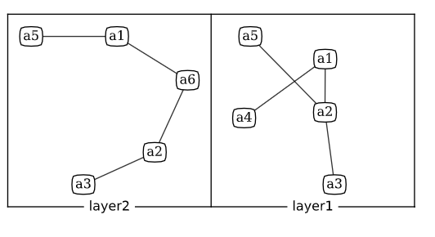
Input file format (basic)
n = ml.read("example1.txt")
ml.plot(n, vertex_labels_bbox = {"boxstyle":'round4', "fc":'white'})
example1.txt
a1,a2,layer1
a2,a3,layer1
a1,a4,layer1
a2,a5,layer1
a5,a1,layer2
a1,a6,layer2
a6,a2,layer2
a2,a3,layer2

Slide 23
Input file format (full)
#TYPE multiplex
#LAYERS
research, UNDIRECTED
twitter, DIRECTED
#ACTOR ATTRIBUTES
affiliation, STRING
#VERTEX ATTRIBUTES
twitter, num_tweets, NUMERIC
#EDGE ATTRIBUTES
research, num_publications, NUMERIC
#ACTORS
Luca,ITU
Matteo,UU
Davide,UU
#VERTICES
Luca,twitter,53
Matteo,twitter,13
#EDGES
Luca,Matteo,research,9
Luca,Matteo,twitter
example2.txt

Slide 24
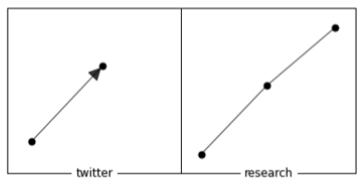
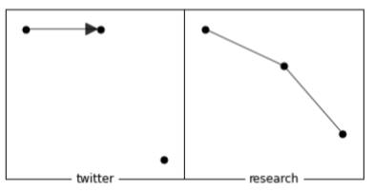
Aligned multiplex networks
n = ml.read("example2.txt")
n = ml.read("example2.txt", aligned = True)
the aligned = True parameter in the second call ensures that there is a vertex to each layer for every actor in the input file.

Slide 25
Getting network data
Networks can be created in the following ways:
From an empty network: ml.empty()
Manually adding layers, vertices, edges, attributes.
Adding networkx graphs as layers.
Reading it from a file: ml.read()
Growing a synthetic network: ml.grow()
Loading a predefined network: ml.data()
aucs, florentine, sampson, bankwiring, tailorshop.

Slide 26
Why network generation?
An example: preferential attachment.
Some applications:
As a source of data, e.g., to test algorithms.
To reason about possible (simple) mechanisms explaining the observed structure of empirical networks (e.g., short average distance, hubs, …).
As a null model.
Multiplex networks are more complex:
Generating models must explain the internal structure of each layer + layer relationships.

Slide 27
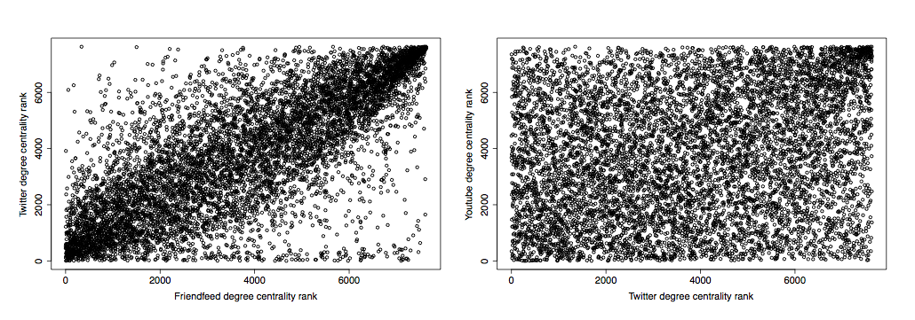


Some empirical evidence

Slide 28
Generation
The package also provides basic functionality to generate synthetic multiplex networks. This problem is approached by allowing layers to evolve at different rates, based on internal or external dynamics. Internal dynamics can be modelled using existing network models (for example, preferential attachment), assuming that how the layer grows can be explained only looking at the layer itself. External dynamics involve importing edges from other layers. Within this perspective the intuition is that relations existing on a layer might naturally expand over time into other layers (e.g., co-workers starting to add each other as friends on Facebook).

Slide 29
L₁
+e
+e
+e
L₁
L₁
L₁
+e
+e
+e
L₂
L₂
L₂
L₂
t₀
t₁
t₂
time

Slide 30
The model in a nutshell
Internal-growth.
The layer grows according to internal dynamics, i.e., something happens independently of the other layers.
External-growth.
The layer grows according to external dynamics, i.e., something happens because of the configuration of an external layer.
No-action.
Nothing happens, i.e., the network remains unchanged.
Magnani and Rossi, 2013a.

Slide 31
Generation
In the following example we create a multiplex network with 3 layers based on the Preferential Attachment and the Erdos-Renyi models.
The first and last layers will only evolve according to their internal models (pr.external = 0), while the second will have a probability of .8 of evolving according to external dynamics, that is, importing edges from other layers (pr.external = .8).
By defining pr.internal and pr.external, we are also implicitly defining pr.no.action (1 minus the other probabilities, for each field/layer). In the example, the third layer grows at a lower speed than the others, having an (implicitly defined) pr.no.action of .1.
The probability to import edges from the other layers in case external events happen is specified using a dependency matrix. The following matrix specifies that the second layer should import edges from the first layer with probability 1 if an external evolutionary event is triggered. It is expected that the values on each row of the matrix add to 1.

Slide 32
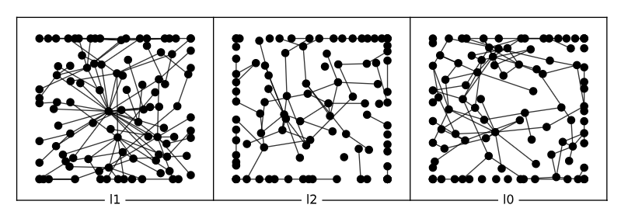
An example
pa = ml.evolution_pa(3,1)
er = ml.evolution_er(100)
models = [ pa, er, er ]
pr_int = [ 1, .2, .9 ]
pr_ext = [ 0, .8, 0 ]
Preferential attach.
Erdős–Rényi
Erdős–Rényi
100% internal growth
80% external
growth
100% internal growth
20% internal
growth
dep = [ [1, 0, 0], [1, 0, 0], [0, 0, 1] ]

Slide 33
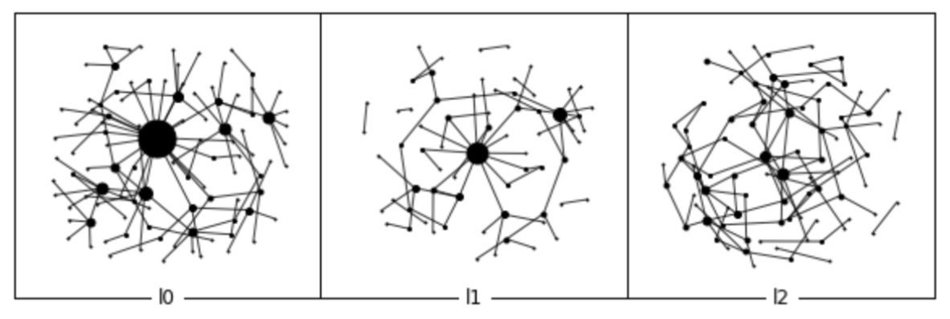
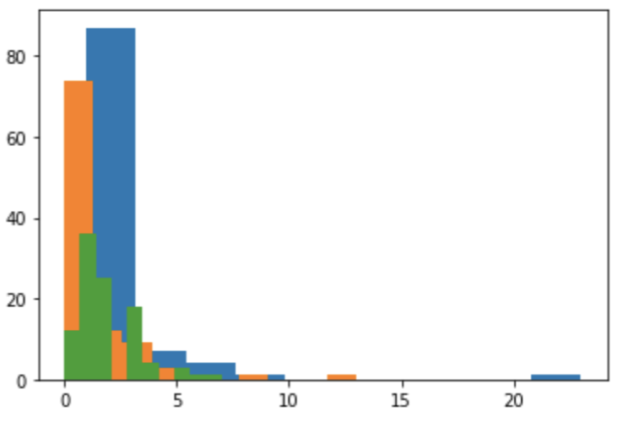
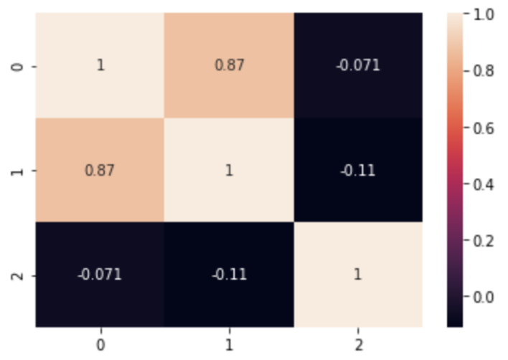
Let’s generate
generated_mix = ml.grow(100, 100, models, pr_int, pr_ext, dep)
ml-net [100 actors, 3 layers, 300 vertices, 212 edges (212,0)]

Slide 34
Getting network data
Networks can be created in the following ways:
From an empty network: ml.empty()
Manually adding layers, vertices, edges, attributes.
Adding networkx graphs as layers.
Reading it from a file: ml.read()
Growing a synthetic network: ml.grow()
Loading a predefined network: ml.data()
aucs, florentine, sampson, bankwiring, tailorshop.

Slide 35
Included datasets
Name | Attributes | Layers | Actors | Edges
florentine | Y (numeric) | 2 | 16 | 35
monastery | Y (ranks) | 10 | 18 | 510
bankwiring | Y (numeric) | 6 | 14 | 110
tailorshop | N | 4 | 39 | 552
aucs | Y (categorical) | 5 | 61 | 620
ml.data("aucs")

Slide 36
NETWORK VISUALIZATION
Part 2

Slide 37

data
AUCS
(Aarhus University Computer Science)
61 employees (out of 142 – includes professors, postdoctoral researchers, PhD students and administration staff)
5 unweighted undirected layers:
1) current working relationships,
2) repeated leisure activities,
3) regularly eating lunch together,
4) co-authorship of a publication,
5) friendship on Facebook.
1-3 collected via a questionnaire (edge is present even when not reciprocated)
4 via DBLP
5 via Facebook API

Slide 38
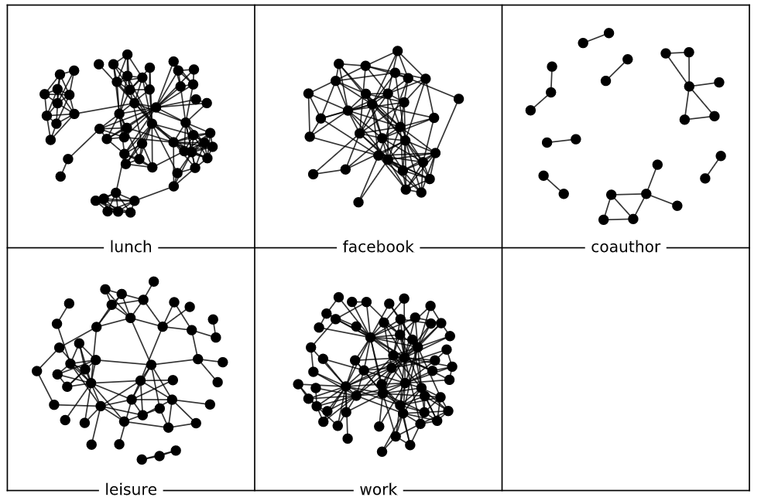
Explore AUCS
net=ml.data("aucs")
net
ml.layers(net)
df(ml.actors(net))
df(ml.vertices(net))
df(ml.edges(net))
df(ml.attributes(net))

Slide 39
uunet.multinet provides a basic visualization function in the multiforce layout, used for all graph visualizations. Inside each layer the algorithm uses a force-based approach as in the commonly used Fruchterman-Reingold layout, to keep adjacent nodes close to each other, but in addition it also applies forces to the vertices so that they remain aligned to vertices with the same actor on other layers.
In addition, in case the network contains multiple components it is possible to specify a gravity force, that attracts the vertices towards the center of their layer so that the distance between the components is controlled.
w_in
vertex repulsion
vertex attraction
gravity
w_inter
gravity
w_in
vertex repulsion
vertex attraction

Slide 40
net = ml.data("aucs")
l1 = ml.layout_multiforce(net, w_inter = [0], gravity = [1])
ml.plot(net, layout = l1, grid = [2, 3], vertex_labels = [""])

Slide 41
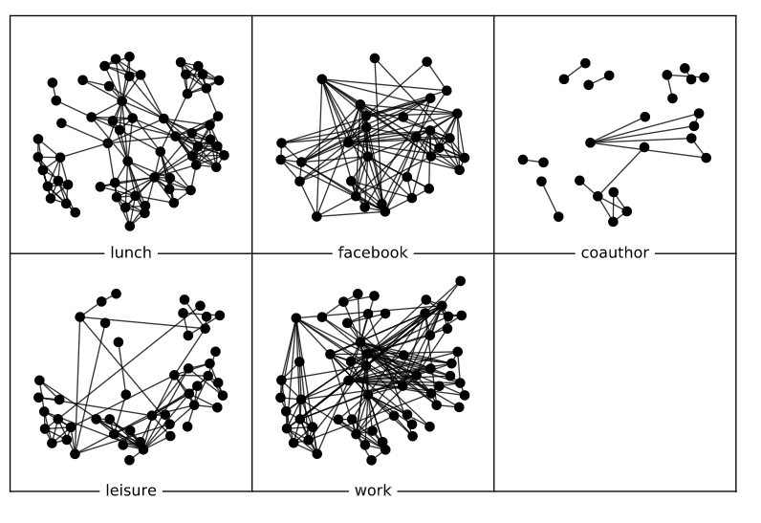
l2 = ml.layout_multiforce(net, w_inter = [1], w_in = [1, 0, 0, 0, 0], gravity = [1, 0, 0, 0, 0])
ml.plot(net, layout = l2, grid = [2, 3], vertex_labels = [""])

Slide 42
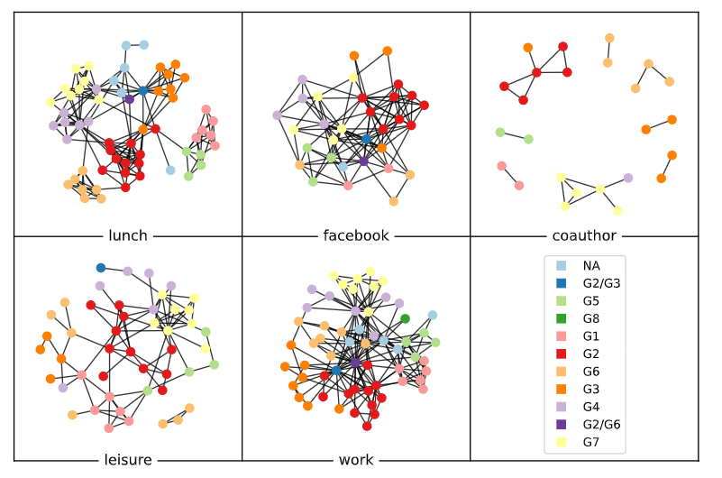
visual exploration
groups = ml.get_values(net,
actors = ml.vertices(net)["actor"],
attribute = “group")
gr = ml.values2graphics(groups)
ml.plot(net, layout = l1, grid = [2, 3],
vertex_labels = "",
vertex_color = gr["colors"],
legend = gr["legend"],
legend_loc = [.73,1])

Slide 43
Task: visual exploration
Use the code in the previous slides to visualize: - the network coloring each node according to its “group” attribute.
Try both with and without inter-layer alignment (any value), which strategy provides most insights?
(6 minutes)

Slide 44
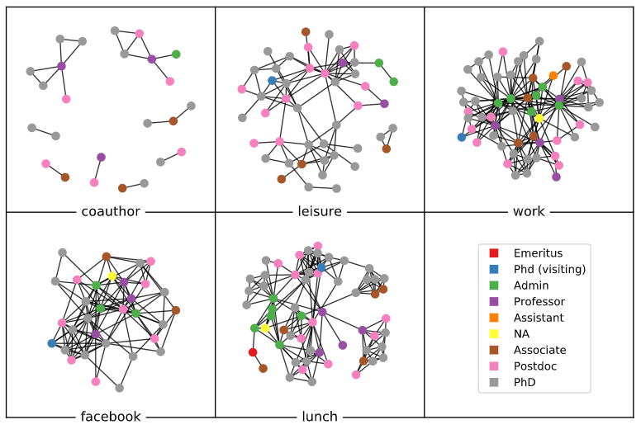
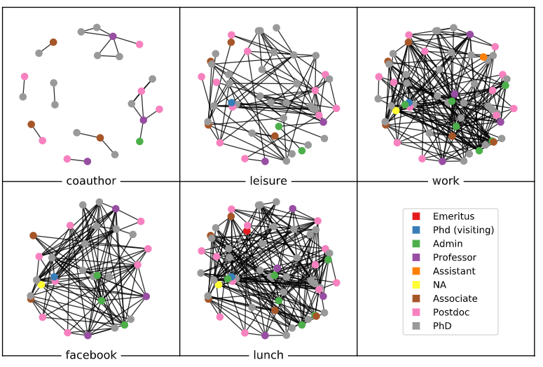
Not aligned
Aligned

Slide 45
Some final considerations
Multilayer network visualization is in its infancy, and will be a very active research sub-area in the near future (according to us).
If interested, look at what the visualization community is doing: McGee et al. (2019).
The approach presented above can be useful for small networks.
Otherwise we will need interactivity.
Later we cover network measures: these can also be visualized with traditional types of plots without plotting the network structure.

Slide 46
MEASURES
Part 3

Slide 47
Summary statistics
We can focus on each layer at a time, considering it as an independent graph. For example, ml.summary() computes a selection of measures on all the layers, and also on the flattened network.
Before you execute summary()
What is the layer with highest density?
What is the layer with highest clustering coefficient?

Slide 48
We can focus on each layer at a time, considering it as an independent graph. For example, ml.summary() computes a selection of measures on all the layers, and also on the flattened network.
 | layer | n | m | dir | nc | slc | dens | cc | apl | dia
0 | coauthor | 25 | 21 | False | 8 | 6 | 0.070000 | 0.428571 | 1.666667 | 3
1 | leisure | 47 | 88 | False | 2 | 44 | 0.081406 | 0.343066 | 3.122622 | 8
2 | work | 60 | 194 | False | 1 | 60 | 0.109605 | 0.338786 | 2.390395 | 4
3 | facebook | 32 | 124 | False | 1 | 32 | 0.250000 | 0.480569 | 1.955645 | 4
4 | lunch | 60 | 193 | False | 1 | 60 | 0.109040 | 0.568926 | 3.188701 | 7

Slide 49
To compute other functions or perform another type of layer-by-layer analysis we can convert the layers into networkx objects, using to_nx_dict(). Once the networkx objects have been generated, all the network measures available in networkx can be used. The following code, for example, uses networkx to compute the assortativity of the facebook layer:
layers = ml.to_nx_dict(net)
layers["facebook"]
nx.degree_assortativity_coefficient(layers["facebook"])

Slide 50
Comparing layers
layer_comparison() allows us to compare layers using several different approaches. All the methods mentioned explained and evaluated by Brodka et al. (2017).
e.g. to quantify the difference between the degree distributions in different layers we can use Jeffrey dissimilarity function (the higher the values, the most dissimilar the two layers).
df( ml.layer_comparison(net, method = "jeffrey.degree") )
 | coauthor | leisure | work | facebook | lunch
coauthor | 0.000000 | 0.420768 | 2.896653 | 1.328825 | 0.837241
leisure | 0.420768 | 0.000000 | 2.021401 | 1.017798 | 0.710679
work | 2.896653 | 2.021401 | 0.000000 | 0.452108 | 0.591749
facebook | 1.328825 | 1.017798 | 0.452108 | 0.000000 | 0.211845
lunch | 0.837241 | 0.710679 | 0.591749 | 0.211845 | 0.000000

Slide 51
Comparison functions
Overlapping | jaccard coverage sm rr hamann | actors edges triangles
Distribution dissimilarity | dissimilarity KL jeffrey | degree
Correlation | pearson rho | degree
df( ml.layer_comparison(net, method = "jaccard.actor") )
df( ml.layer_comparison(net, method = "pearson.degree") )
df( ml.layer_comparison(net, method = "coverage.edges") )

Slide 52
Task: layer comparison
We will compute the following layer comparisons:
jaccard.actors
Higher if many actors are common.
pearson.degree
Higher if actors have high (resp., low) degree in both layers (“popular” actors are popular in both).
jaccard.edges
Higher if actors are connected to the same individuals in both layers.
coverage.edges
Percentage of edges in one layer that are also present in the other.

Slide 53
Some examples
df( ml.layer_comparison(net, method = "pearson.degree") )
 | coauthor | leisure | work | facebook | lunch
coauthor | 1.000000 | 0.312560 | 0.148637 | 0.281517 | 0.246475
leisure | 0.312560 | 1.000000 | 0.547277 | 0.378174 | 0.540601
work | 0.148637 | 0.547277 | 1.000000 | 0.480845 | 0.427194
facebook | 0.281517 | 0.378174 | 0.480845 | 1.000000 | 0.068050
lunch | 0.246475 | 0.540601 | 0.427194 | 0.068050 | 1.000000
df( ml.layer_comparison(net, method = "jaccard.edges") )
 | coauthor | leisure | work | facebook | lunch
coauthor | 1.000000 | 0.178439 | 0.064677 | 0.277273 | 0.339100
leisure | 0.178439 | 1.000000 | 0.058394 | 0.158470 | 0.186567
work | 0.064677 | 0.058394 | 1.000000 | 0.101010 | 0.091371
facebook | 0.277273 | 0.158470 | 0.101010 | 1.000000 | 0.205128
lunch | 0.339100 | 0.186567 | 0.091371 | 0.205128 | 1.000000

Slide 54
Pearson degree

Slide 55
Coverage edges

Slide 56
Degree & Actor metrics
Overall degree ad layer specific degree (or combination of layers):
ml.degree(net,actors=['U4’])
ml.degree(net,actors=['U4'], layers=['facebook','lunch'])
 | actor | lunch | facebook | coauthor | leisure | work
0 | U4 | 15 | 12 | NaN | 1.0 | 21
1 | U67 | 12 | 13 | NaN | 2.0 | 20
2 | U91 | 7 | 14 | 3.0 | 14.0 | 8
3 | U79 | 13 | 15 | NaN | 7.0 | 9
4 | U123 | 6 | 11 | NaN | NaN | 27
U4 and U91 show very different activities on the different layers
ml.degree_deviation(net,actors=['U4','U91’])
[8.133879763065101, 4.261455150532504]

Slide 57
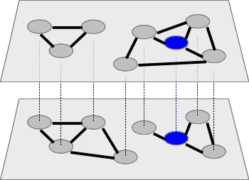
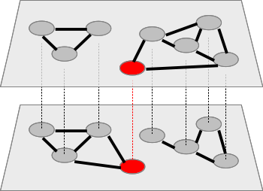
Neighborhood
Degree: 3
Central
Degree: 2
Peripheral
Degree 6
Degree 4
Degree: 3
Central
Degree: 2
Peripheral
Neighbors: 3
Central
Neighbors: 4
Very central
The neighbors of an actor a are those distinct actors that are adjacent to a on a specific input layer, or on a set of input layers. While on a single layer degree and neighborhood have the same value, they can be different when multiple layers are taken into account, because the same actors can be adjacent on multiple layers leading to a higher degree but not a higher neighborhood.

Slide 58
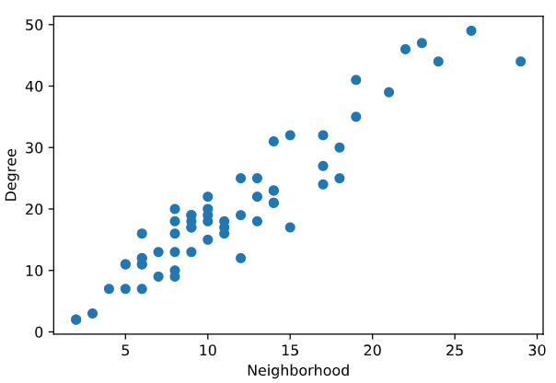
Neighborhood
ml.degree(net, actors = ["U4"], layers = ["work", "lunch"])
[36]
ml.neighborhood(net, actors = ["U4"], layers = ["work", "lunch"])
[21]

Slide 59
xNeighborhood
xneighborhood() (exclusive neighborhood) counts the neighbors that are adjacent to a specific actor only on the input layer(s) (Berlingerio et al., 2012a)
3 neighbors
0 x-neighbors
2 neighbors
2 x-neighbors
ml.xneighborhood(net, actors = ["U91"], layers = ["facebook", "leisure"])
[22]
ml.neighborhood(net, actors = ["U91"], layers = ["facebook", "leisure"])
[13]

Slide 60
Layer relevance
3 neighbors: relevance 100%
3 neighbors
2 neighbors: relevance 50%
4 neighbors
Notes:
What happens if I only KEEP

Slide 61
Exclusive layer relevance
3 neighbors: relevance 100%
0 x-neighbors
x-relevance: 0%
3 neighbors
2 neighbors: relevance 50%
2 x-neighbors
x-relevance: 50%
4 neighbors

Slide 62
Relevance
ml.relevance(net, actors=["U4"], layers=['facebook’])
ml.xrelevance(net, actors=["U4"], layers=['facebook'])
actor | coauthor | leisure | work | facebook | lunch
U4 | NaN | 0.038462 | 0.807692 | 0.461538 | 0.576923
U67 | NaN | 0.086957 | 0.869565 | 0.565217 | 0.521739
U91 | 0.136364 | 0.636364 | 0.363636 | 0.636364 | 0.318182
U79 | NaN | 0.291667 | 0.375000 | 0.625000 | 0.541667
U123 | NaN | NaN | 0.931034 | 0.379310 | 0.206897
Relevance
actor | lunch | facebook | coauthor | leisure | work
U4 | 0.000 | 0.192308 | NaN | 0.000000 | 0.153846
U67 | 0.000 | 0.130435 | NaN | 0.000000 | 0.217391
U91 | 0.000 | 0.318182 | 0.0 | 0.181818 | 0.000000
U79 | 0.125 | 0.166667 | NaN | 0.041667 | 0.083333
U123 | 0.000 | 0.068966 | NaN | NaN | 0.517241
xRelevance

Slide 63
communities
Part 4

Slide 64
Agenda
A simple example (generalized Louvain).
An overview of the available algorithms.
Experiments.
Comparing results of different algorithms.
Testing different parameters.

Slide 65
A simple example (1)
The function glouvain() uses the objective function defined by Mucha et al. (2010) to find community structures across layers, where vertices in different layers can belong to the same or a different community despite corresponding to the same actor.
clust = ml.glouvain(net)
df(clust)
 | actor | layer | cid
0 | U22 | lunch | 0
1 | U22 | coauthor | 0
2 | U22 | leisure | 0
3 | U22 | work | 0
4 | U26 | lunch | 0
... | ... | ... | ...

Slide 66
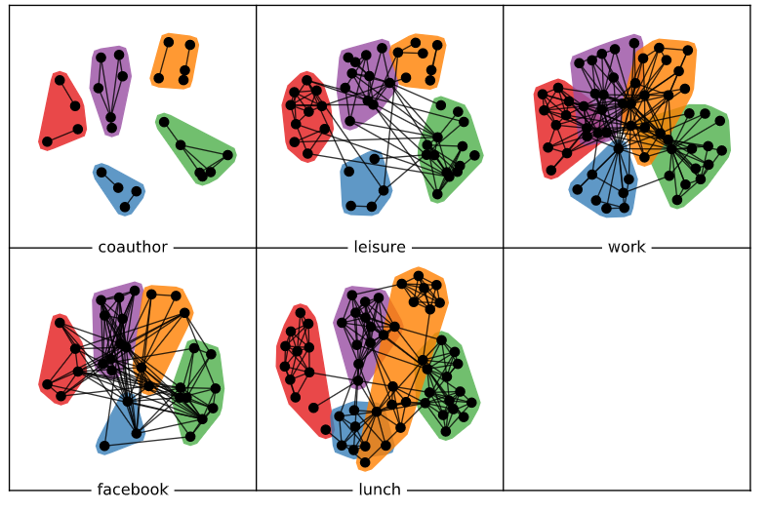
A simple example (2)
l=ml.layout_multiforce(net, w_inter = [1], w_in = [0, 0, 1, 0, 1], gravity = [0, 0, 1, 0, 1])
ml.plot(net, com = clust, vertex_labels = [], layout = l, grid = [2, 3])

Slide 67
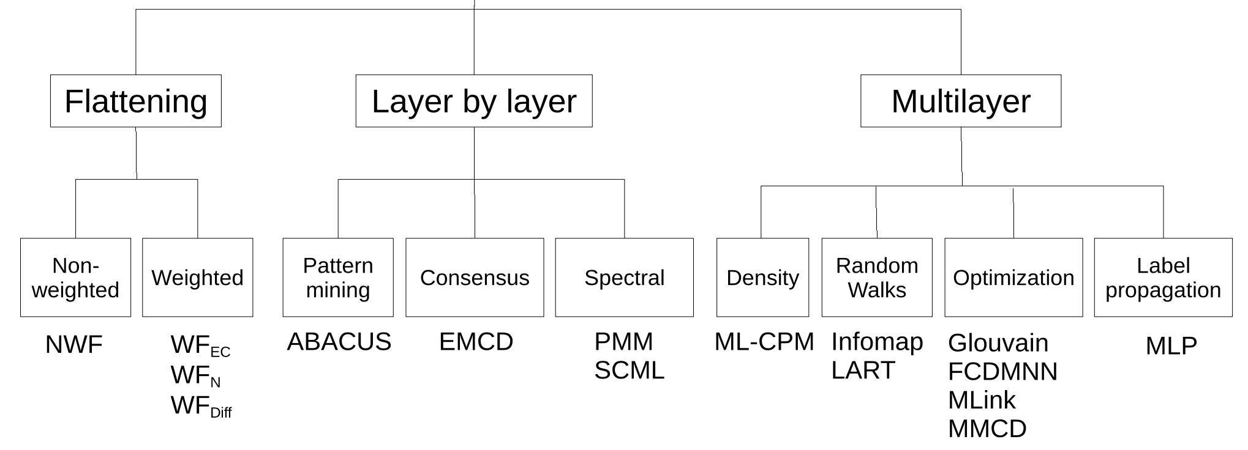
Available algorithms
Magnani et al., 2021

Slide 68
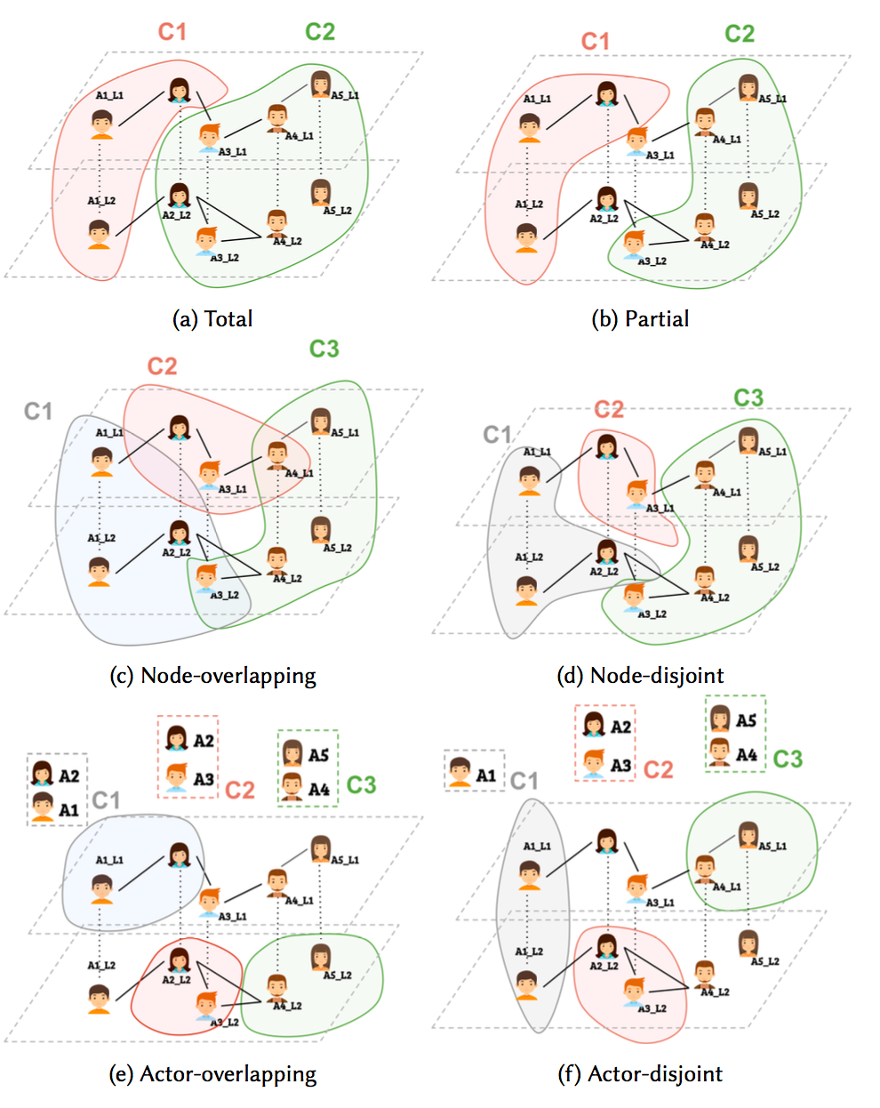

Slide 69
Available algorithms:
Name | Ref for ML version | Type
Multilayer clique percolation (ML-CPM) | Afsarmanesh and Magnani, 2018 | Overlapping, partial
ABACUS | Berlingerio et al., 2013 | Overlapping, partial
Infomap | De Domenico et al., 2015 | Partitioning or overlapping, undirected or directed networks
Generalized Louvain | Mucha et al., 2010 | Partitioning
Multi Dimensional Label Propagation | Boutemine and Bouguessa, 2017 | Partitioning
Flattening (weighted) | Berlingerio et al., 2011 | Partitioning (*)
Flattening (unweighted) | Berlingerio et al., 2011 | Partitioning (*)

Slide 70
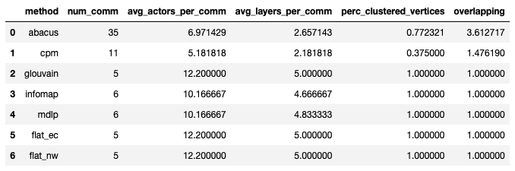
A comparison: statistics

Slide 71
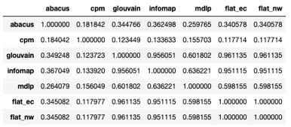
A comparison: omega index
nmi() also available, for partitioning methods

Slide 72
Back to generalized Louvain
Modularity is a clustering quality function introduced by Mark Newman in 2001.

Slide 73
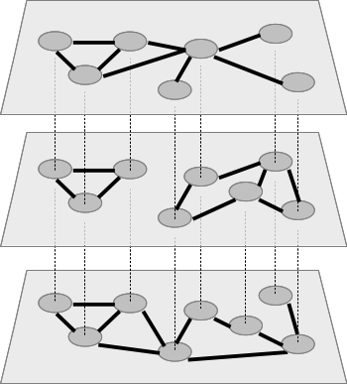
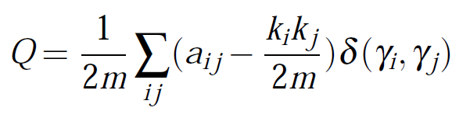
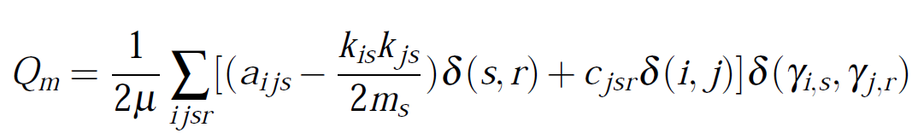
Multiplex modularity
nodes on same network
same node on different networks

Slide 74
A comparison: modularity
print( ml.modularity(net, comm_dict["glouvain"]) )
0.5238050562810481
print( ml.modularity(net, comm_dict["mdlp"]) )
0.4725328597429617
print( ml.modularity(net, comm_dict["infomap"]) )
0.2558495527561328
print( ml.modularity(net, comm_dict["flat_ec"]) )
0.5218939280099651
print( ml.modularity(net, comm_dict["flat_nw"]) )
0.5218939280099655

Slide 75
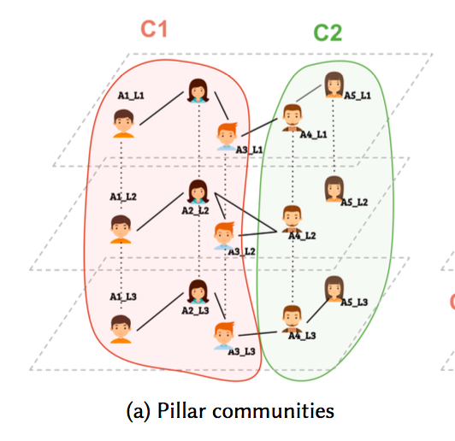
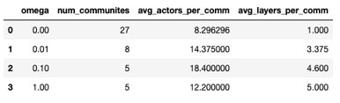
The results of gLouvain are highly dependent on the parameter omega: higher values will result in communities spanning multiple layers, because including the same actor on different layers in the same community increases the value of modularity. Omega = 0, having the same actors on different layers in the same community does not contribute to modularity.

Slide 76
Clique percolation method
Palla, Gergely, Imre Derényi, Illés Farkas, and Tamás Vicsek. 2005. “Uncovering the Overlapping Community Structure of Complex Networks in Nature and Society.” Nature 435 (7043).
Find max-cliques of size ≥ k
CPM(k)
Notes:
Contained

Slide 77
Clique percolation method
Find max-cliques of size ≥ k
CPM(k)

Slide 78
Clique percolation method
Adjacency: k-1 common nodes
CPM(k)

Slide 79
Clique percolation method
Find spanning trees (that is,
connected components)
CPM(k)

Slide 80
Clique percolation method
CPM(k)

Slide 81
Clique percolation method
CPM(k)

Slide 82
Clique percolation method
CPM(k)

Slide 83
Multiplex clique percolation method
CPM(k,m)

Slide 84
Assessment
Link to be sent by email.

Slide 85
References (1)
Afsarmanesh N, Magnani M (2018). “Partial and Overlapping Community Detection in Multiplex Social Networks.” In Social Informatics.
Berlingerio M, Coscia M, and Giannotti F.Finding and characterizing communities in multidimen- sional networks. In International Conference on Advances in Social Networks Analysis and Mining (ASONAM), pages 490–494. IEEE Computer Society Washington, DC, USA, 2011.
Berlingerio M, Coscia M, Giannotti F, Monreale A, Pedreschi D (2012). “Multidimensional Net- works: Foundations of Structural Analysis.” World Wide Web. ISSN 1386-145X.
Berlingerio M, Pinelli F, Calabrese F (2013). “ABACUS: Apriori-Based Community Discovery in Multidimensional Networks.” Data Mining and Knowledge Discovery, 27.
Boutemine O and Bouguessa M. “Mining Community Structures in Multidimensional Networks.” ACM Transactions on Knowledge Discovery from Data, 11(4):1–36, jun 2017. ISSN 15564681. doi: 10.1145/3080574.
Brodka P, Chmiel A, Magnani M, Ragozini G (2018). “Quantifying Layer Similarity in Multiplex Networks: A Systematic Study.” Royal Society open science, 5(8).
De Domenico M, Lancichinetti A, Arenas A, Rosvall M (2015). “Identifying Modular Flows on Mul- tilayer Networks Reveals Highly Overlapping Organization in Interconnected Systems.” Physical Review X, 5.
Dickison ME, Magnani M, Rossi L (2016). “Multilayer Social Networks.” Cambridge University Press. ISBN 978-1107438750.
Fatemi Z, Magnani M, Salehi M (2018). “A Generalized Force-Directed Layout for Multiplex Sociograms.” In Social Informatics.

Slide 86
References (2)
Interdonato R, Magnani M, Perna D, Tagarelli A, and Vega D, “Multilayer network simplifica- tion: Approaches, models and methods,” Computer Science Review, vol. 36, p. 100246, 2020, doi: 10.1016/j.cosrev.2020.100246.
Kivelä M, Arenas A, Barthelemy M, Gleeson JP, Moreno Y, Porter MA (2014). “Multi-layer Networks.” Journal of Complex Networks, 2(3), 203–271.
Magnani M, Rossi L (2011). “The ML-Model for Multi-layer Social Networks.” In ASONAM, pp. 5–12. IEEE Computer Society. ISBN 9781612847580.
Magnani M, Rossi L (2013a). “Formation of Multiple Networks.” In Social Computing, Behavioral- Cultural Modeling and Prediction, pp. 257–264. Springer-Verlag Berlin Heidel- berg. ISBN 978-3- 642-37209-4.
Magnani M, Rossi L (2013b). “Pareto Distance for Multi-layer Network Analysis.” In AM Green- berg, WG Kennedy, ND Bos (eds.), Social Computing, Behavioral-Cultural Mod- eling and Pre- diction, volume 7812 of Lecture Notes in Computer Science. Springer-Verlag, Berlin, Heidelberg. ISBN 978-3-642-37209-4.
Magnani M, Hanteer O, Interdonato R, Tagarelli A, Rossi L (2021). “Community Detection in Multiplex Networks.” ACM Computing Surveys, 54(3).
McGee F, Ghoniem M, Melançon G, Otjacques B, Pinaud B (2019). "The State of the Art in Multilayer Network Visualization." Computer graphics forum 38(6).
Moreno, J L. (1934). Who Shall Survive? A New Approach to the Problem of Human Interrelations
Mucha PJ, Richardson T, Macon K, Porter MA, Onnela JP (2010). “Community Structure in Time-Dependent, Multiscale, and Multiplex Networks.” Science, 328(5980), 876–878. ISSN 0036- 8075.

Slide 87
References (3)
J F Padgett & P D McLean (2006) Organizational Invention and Elite Transformation: The Birth of Partnership Systems in Renaissance Florence. American Journal of. Sociology, 111(5)
D. Vega and M. Magnani, “Foundations of Temporal Text Networks,” Applied Network Science, vol. 3, no. 1, p. 25, 2018, doi: 10.1007/s41109-018-0082-3.

Slide 88

Mikko Kivelä, Alexandre Arenas, Marc Barthelemy, James P. Gleeson, Yamir Moreno, and Mason A. Porter. 2014. “Multilayer Networks.” Physics and Society. Journal of Complex Networks 2 (3).
Stefano Boccaletti, Ginestra Bianconi, Regino Criado, Charo I. Del Genio, Jesús Gómez-Gardeñes, Miguel Romance, Irene Sendiña-Nadal, Zhen Wang, and Massimiliano Zanin. 2014. “The Structure and Dynamics of Multilayer Networks.” Physics Reports 544 (1).
Ginestra Bianconi. Multilayer Networks: Structure and Function. Oxford University Press. 2018.
http://multilayer.it.uu.se
(on diffusion/propagation) Mostafa Salehi, Rajesh Sharma, Moreno Marzolla, Matteo Magnani, Payam Siyari, and Danilo Montesi. 2015. “Spreading Processes in Multilayer Networks.” IEEE Transactions on Network Science and Engineering 2 (2): 65–83.
(on layer comparison) Brodka, P., Chmiel, A., Magnani, M., and Ragozini, G. 2018. “Quantifying layer similarity in multiplex networks: a systematic study“. Royal Society Open Science, 5(8).
(on clustering) Matteo Magnani, Obaida Hanteer, Roberto Interdonato, Luca Rossi and Andrea Tagarelli. “Community Detection in Multiplex Networks.” ACM Computing Surveys,
(on simplification) Roberto Interdonato, Matteo Magnani, Diego Perna, Andrea Tagarelli and Davide Vega. “A survey on methods for multilayer network simplification“. Computer Science Review.
R: RSiena, multiplex

Slide 89
Analysis of multiplex networks with Python
Matteo Magnani
InfoLab, Dept. of Information Technology
Uppsala University
http://infolab.it.uu.se @uuinfolab
matteo.magnani@it.uu.se @matmagnani
Luca Rossi
NERDS group
IT University of Copenhagen
http://nerds.itu.dk @nerdsitu
lucr@itu.dk @LR
^{This work was} partially supported by the European Community through the project “Values and ethics in Innovation for Responsible Technology in Europe” (Virt-EU) funded under Horizon 2020 ICT-35-RIA call Enabling Responsible ICT-related Research and Innovation.

Slide 90
Additional material

Slide 91
Distance between two nodes?
A2
A2
A1
A4
A1
A4
A3
A3
What is the distance between A1 and A4?
Magnani and Rossi, 2013a

Slide 92
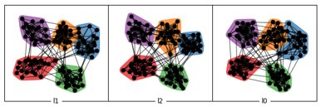
Community generation
See companion material for more details.

Slide 93
How do information / behaviors spread?
IEEE Transactions on Network Science and Engineering 2015. 2 (2): 65–83.

